Slide 1



Integrated Program in Business Analytics
Adidas US Sales Clustering
Group A – Batch 13
John Reynolds | Anuj Tiwari| Ashish Mahajan|
Suraj Gutte | Trompress Fransis | Simrat Kaur |
Rahila Rajvada | Priya Roy

Slide 2
Agenda
Business Problem and Objectives
Executive Summary
Data Overview and Key Business Assumptions (if any)
Data Preparation and Pre-processing
Sanity checks, treatment and transformations for analytical dataset preparation
Exploratory Data Analysis
Key Business Findings and Insights
Model Development and Validations
Model comparisons on key scoring metrics and model finalization
Dashboarding (required only when it is in scope of analysis)
Businesss Recommendations and Potential Business Impact
Next Steps
Appendix

Slide 3


Problem Statement
Segment the retailers based on various attributes such as type of product purchases, profit, total sales, sales method in order to better facilitate and improve the processes wherever necessary
Primary Objectives
Higher Revenue
Customer Understanding
Target Marketing

Slide 4
About the Dataset
Adidas US sales dataset is a collection of data that includes information on the sales of Adidas products. This type of dataset includes details such as the number of units sold, the total sales revenue, the location of the sales, the type of product sold, and any other relevant information. The general invoice timestamps range from 1/1/2020 to 31/12/2021
Assumptions
The Retailer ID in the data is redundant data as it is not giving any meaningful insight.
Data is authentic / general purpose retail data and inferences may lead to valur to business.
Operating margin is ratio and is treated accordingly

Slide 5
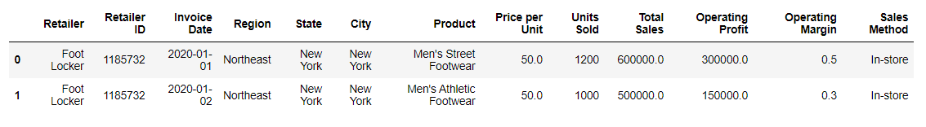
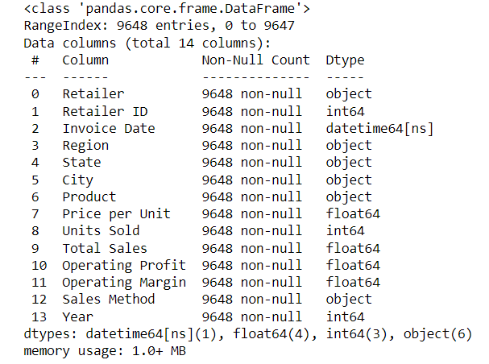
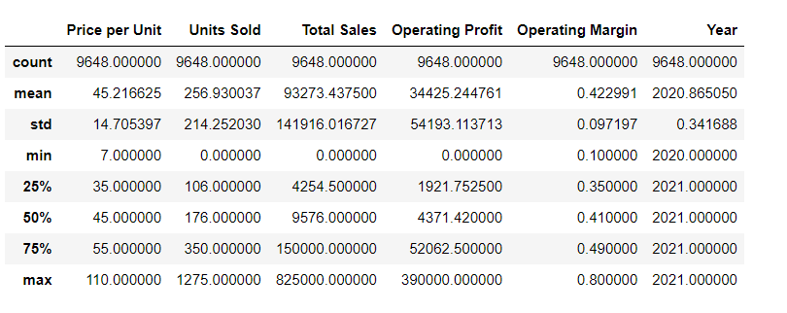
About the Dataset
Numerical features insights
Categorical features insights

Slide 6
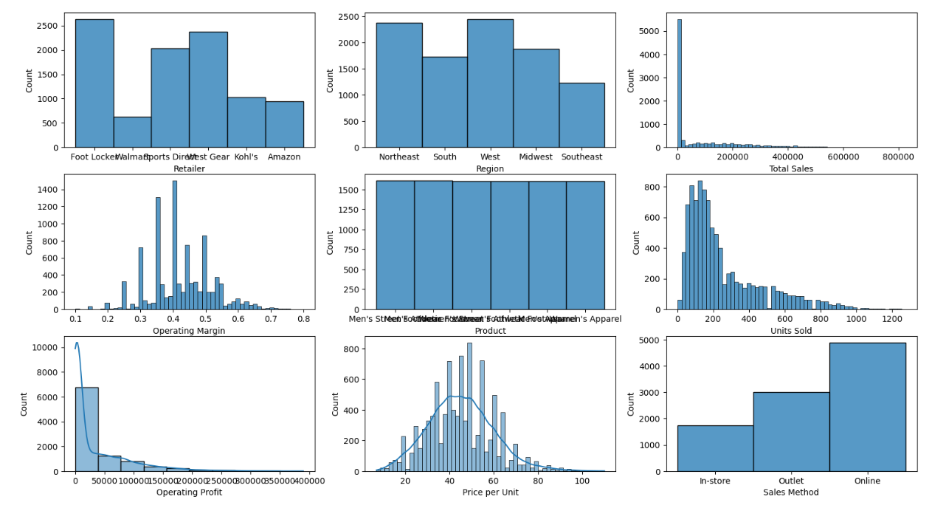
Exploratory Data Analysis Univariate
Footlocker is the most frequent occurring retailer in the dataset
Total Sales, Operating profit, and Units Sold are interrelated and are right skewed
'Price Per unit' is normally distributed. 'Operating Margin' almost takes the shape of a bell
Online sales are the highest
All products are almost equally distributed
North-east and West contribute to the most observed regions throughout the dataset

Slide 7
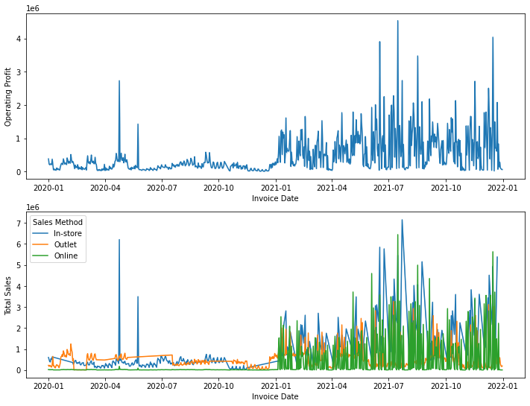
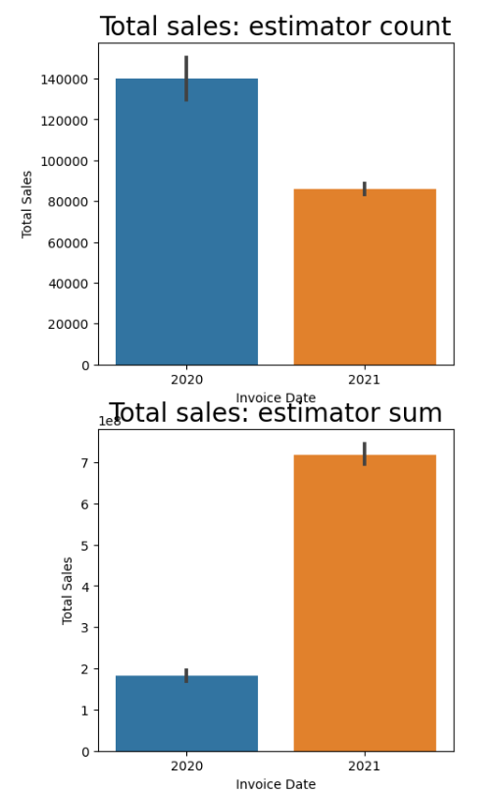
Exploratory Data Analysis Bi-variate Total Sales and Operating Profit
Significant improvement in sales and operating profit is evident in 2021
Less number of transactions and bulk sales evident in 2021
Online sales have surfaced in the year 2021 which can suggest the possible jump in the overall sales

Slide 8
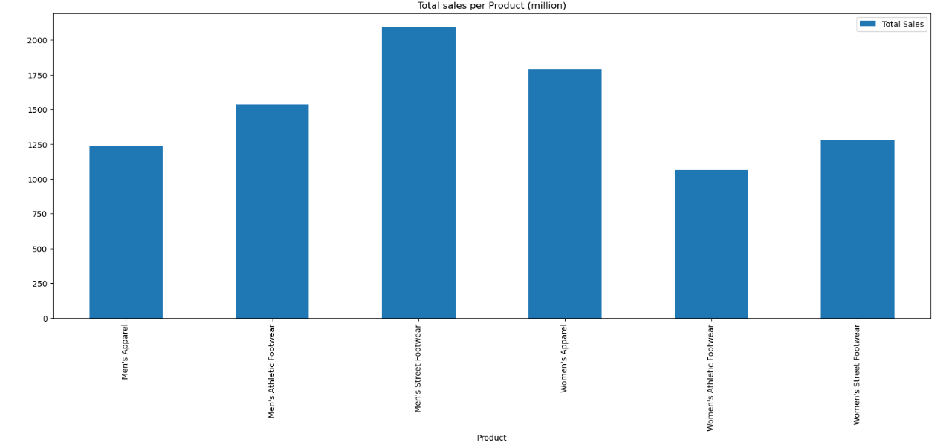
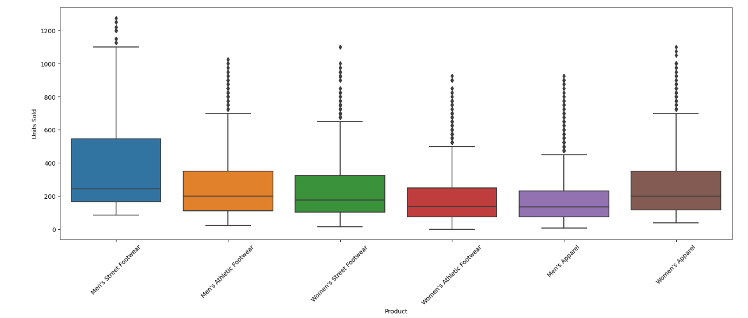
Exploratory Data Analysis Bi-variate Product
Men’s Street footware followed by Women’s Appareal are leading products.
Visibly huge number of outliers in each product sale data, perhaps the data is mix of retail sale as well as Wholesale for these products. It could be Retail in first year and Wholesale in second year.
Outliers were not treated by us while evaluation of clusters due to exploratory nature of study.

Slide 9
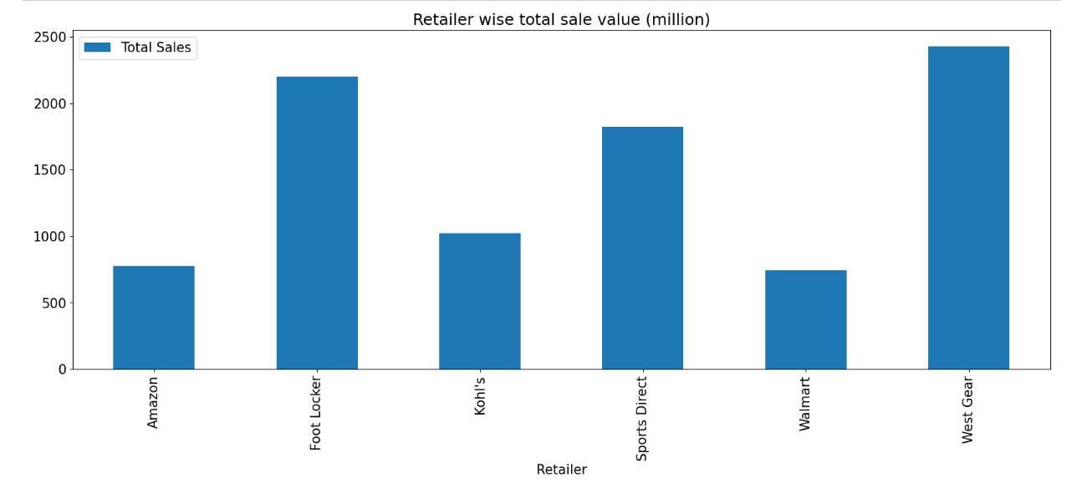
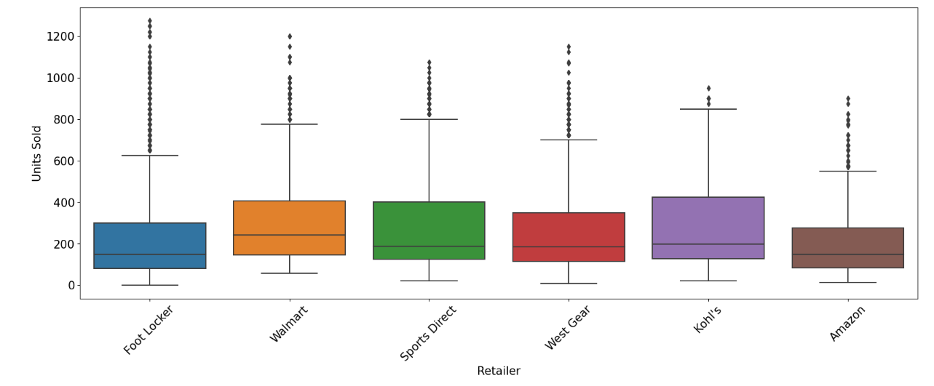
Exploratory Data Analysis Bi-variate Retailer
West gear is the leading Retailer followed by Foot Locker in total Sale revenue.
Visibly huge number of outliers in each Retailer sale data, indicating the data is mix of retail sale and Wholesale insights, perhaps 2020 is retail and 2021 is Whole sale.
Outliers were not treated by us while evaluation of clusters due to exploratory nature of study.

Slide 10
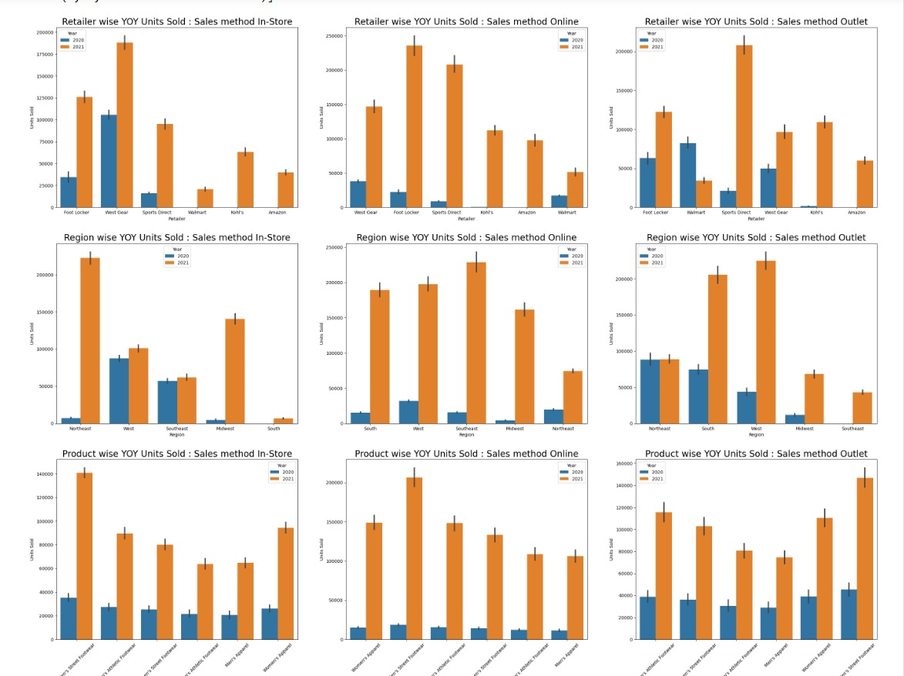
Exploratory Data Analysis Bi-variate Units sold
Instore Sales: Walmart, Kohl's and Amazon also initiated in 2021. Existing players took lead in 2021 as well.
Outlet sales: Walmart sale dropped and Sports direct gained the most in 2021. Amazon started sales in 2021.
Online Sales: Growth by all players in 2021, Amazon started in 2021.
Instore sales: Northeast and Midwest gained the most & West and Southeast were almost stagnant.
Outlet Sales: Northeast no sale growth, South east started and West and South gained the most.
Online sales: Growth in all regions. Max gain by Southeast, South, West and Midwest
Product story: Almost unified sale for all products in 2020 in all sales methods. Men's Street footware, Women’s Appareal and Men’s Athletic footware have grown in all considerably in 2021

Slide 11
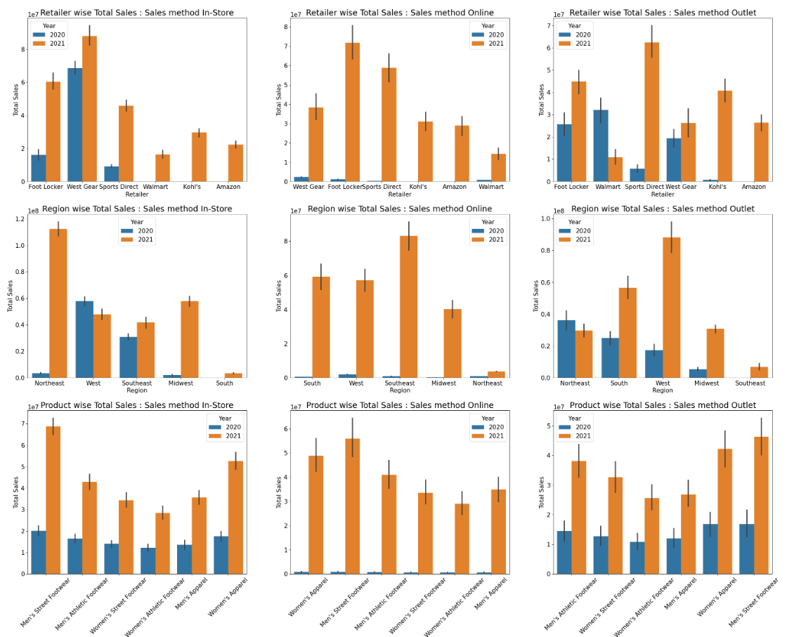
Exploratory Data Analysis Bi-variate Total sales
Instore Sales: Walmart, Kohl's and Amazon also initiated in 2021. Existing players took lead in 2021 as well.
Outlet sales: Walmart sale dropped and Sports direct gained the most in 2021. Kohl’s became 3rd largest retailer. Amazon started sales in 2021.
Online Sales: Growth by all players in 2021, Amazon started in 2021.
Instore sales: Northeast and Midwest gained the most & Southeast was not growing much, West sale dropped.
Outlet Sales: Northeast sale dropped, South east started and West and South gained the most.
Online sales: Growth in all regions. Max gain by Southeast, South, West and Midwest
Product story: Almost unified sale for all products in 2020 in all sales methods. Men's Street footware, Women’s Appareal and Men’s Athletic footware have grown in all considerably in 2021

Slide 12
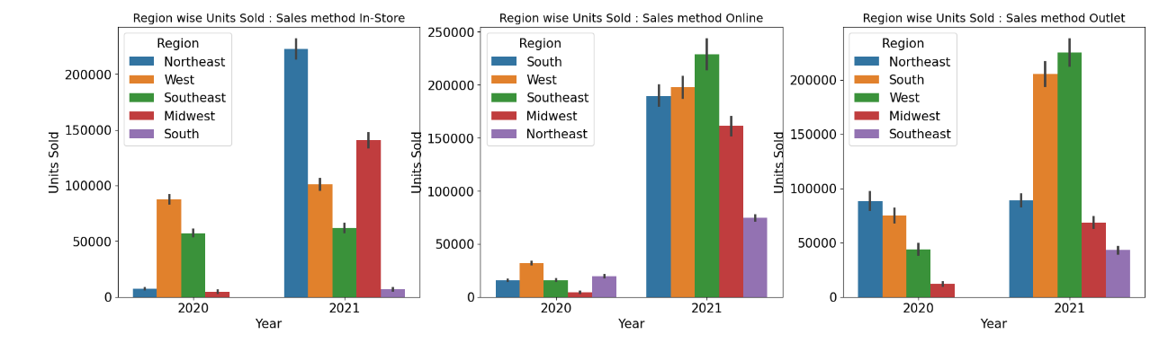
Exploratory Data Analysis Bi-variate Units sold - Region and Sales Method
Instore Sales: Phenomenal growth in Northeast sold largest number of units , Midwest also grown better then the rest, almost no growth in Southeast and sales begun in South in 2021.
Online Sales: Massive sale jump in all regions, Southeast sold largest number units, Midwest sold larger qty than Northeast in 2nd year.
Outlet Sales: Remarkable sale improvement in West, South and Midwest, Almost no sales growth in Northeast, sales begun in Southeast in 2021.

Slide 13
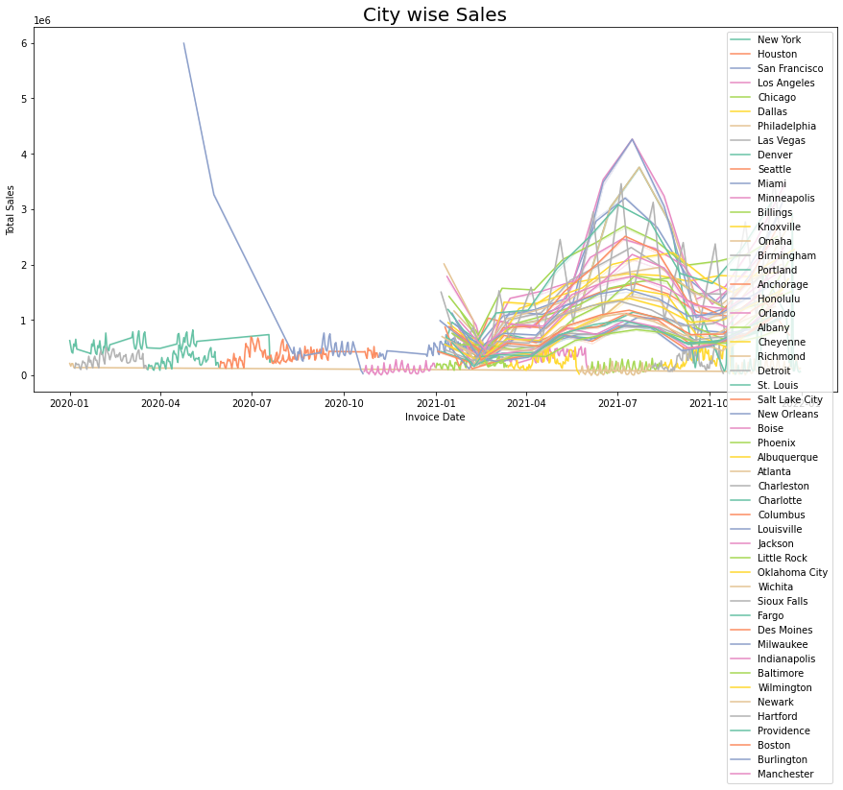
Exploratory Data Analysis Bi-variate City wise Sales
More uniform Total Sales involving more cities evident in 2021
2020 had less frequent city wise purchases, whereas more uniformity across cities is visible in 2021

Slide 14
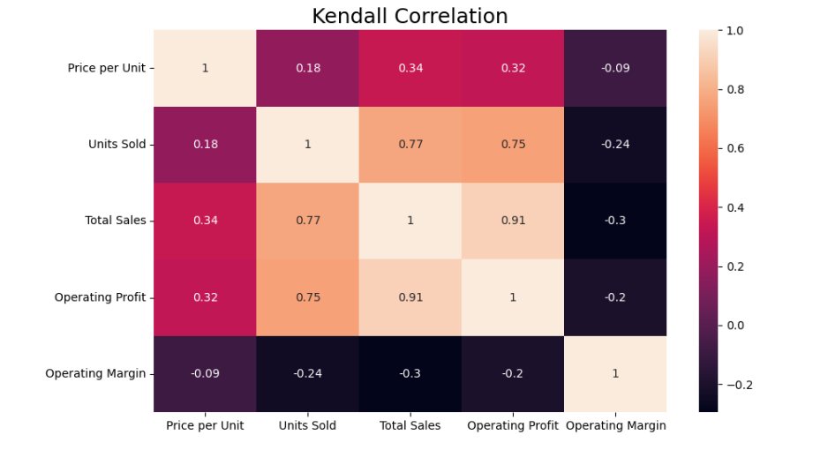
Correlation Plot
Price per unit is positively correlated with Operating Profit, total sales and Units Sold
Total Sales is positively correlated with Operating Profit, units Sold and Price per unit
Negative correlation is evident between Operating margin with Price per unit, Units Sold, Total Sales and Operating Profit
Price per unit is positively correlated with Operating Profit, total sales and Units Sold
Total Sales is positively correlated with Operating Profit, units Sold and Price per unit
Negative correlation is evident between Operating margin with Price per unit, Units Sold, Total Sales and Operating Profit

Slide 15
Clustering

Slide 16
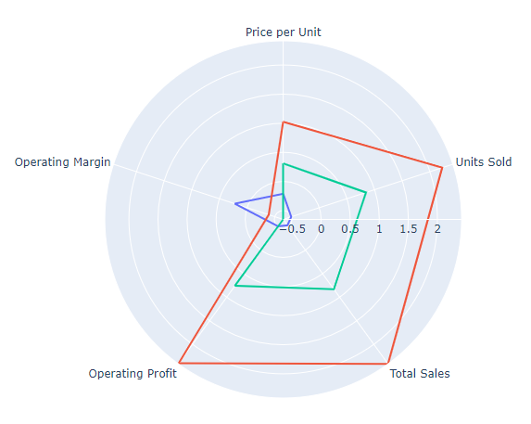
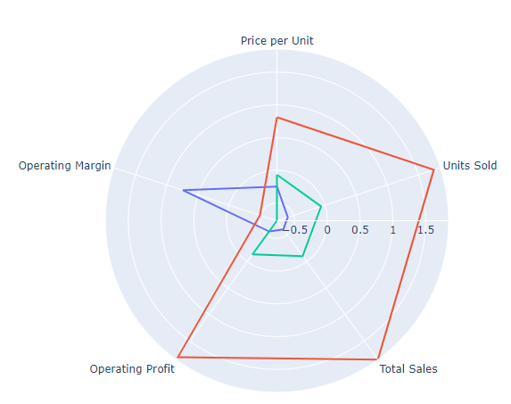
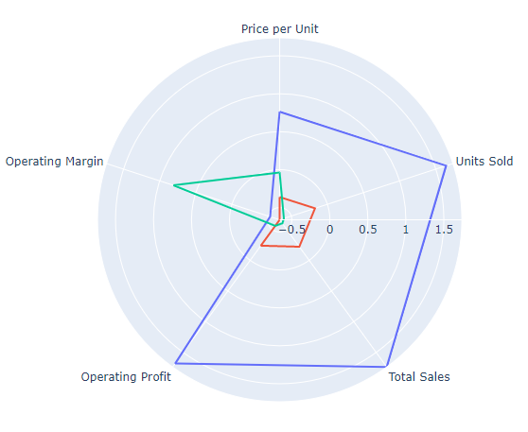
K- Prototype Clustering
Clustering Technique Selection
K – means clustering was initially performed as the base level clustering to compare the results based on the mean
Hierarchal and K-prototype clustering was done going forward. However, all three techniques resulted in clusters with similar characteristics
As K-prototype had the ability to cluster categorical features based on the mode, it was chosen to better interpret the clusters
Hierarchal
Clustering
K- means
Clustering

Slide 17
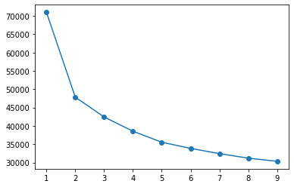
Clustering (K- Prototype Method)
K Prototype which has the ability to cluster categorical features has been selected as it has shown similar clusters when compared to the other clustering methods
3 clusters have been passed as the parameter as per the elbow graph and testing the cluster characteristics with higher numbers
The clusters formed distinctly had the following features
Cluster 1 (blue): Low operating margin but the other features are trending high
Cluster 2 (red): Similar characteristics as cluster 1 but the averages for the features are significantly low
Cluster 3 (green): High operating margin whereas the other features are trending comparatively low

Slide 18
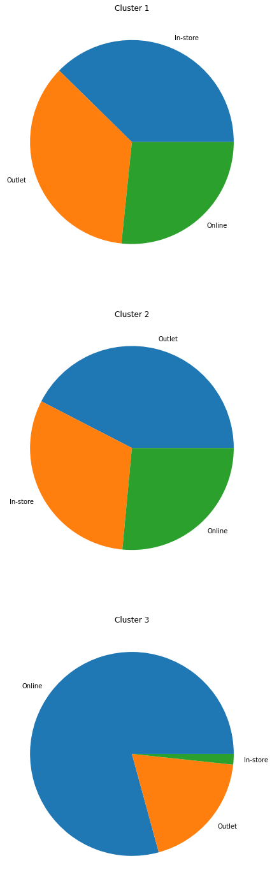
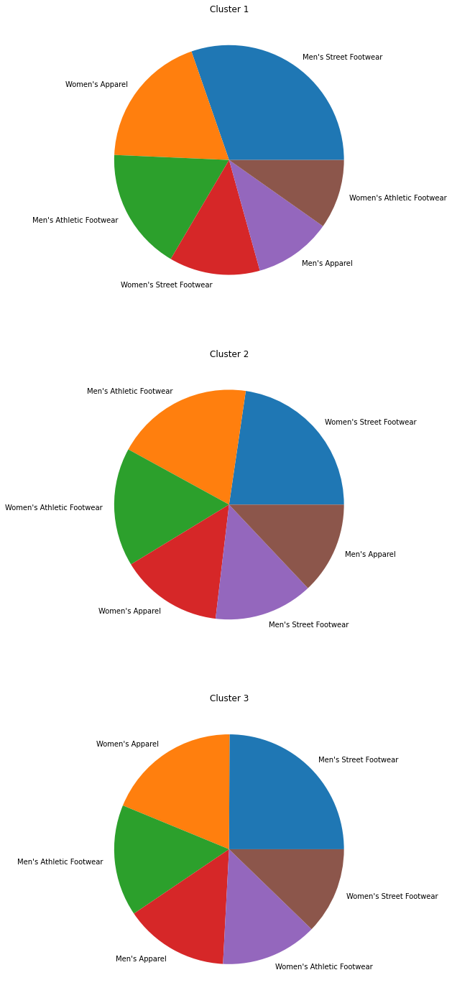
Business Insights in Clusters
Cluster 1 (Low operating margin and high averages of other features)
Sales methods are almost evenly distributed
Women’s apparel is the least occurring item
Cluster 2 (Low operating margin and low averages of other features)
Outlet sales are higher than the in-store sales
Women’s apparel is the least occurring item
Cluster 3 (High operating margin and low averages of other features)
Online sales are significantly higher
Women’s apparel is the most frequently occurring item

Slide 19
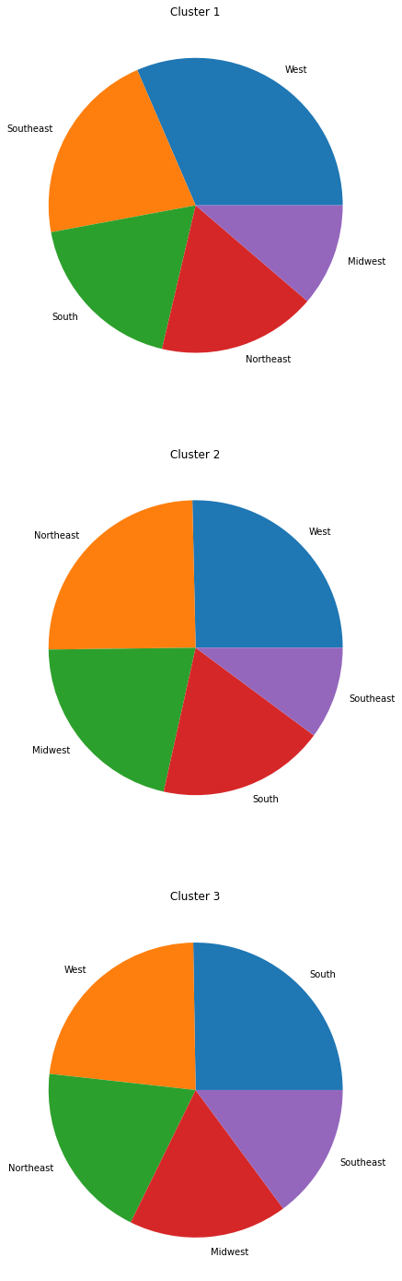
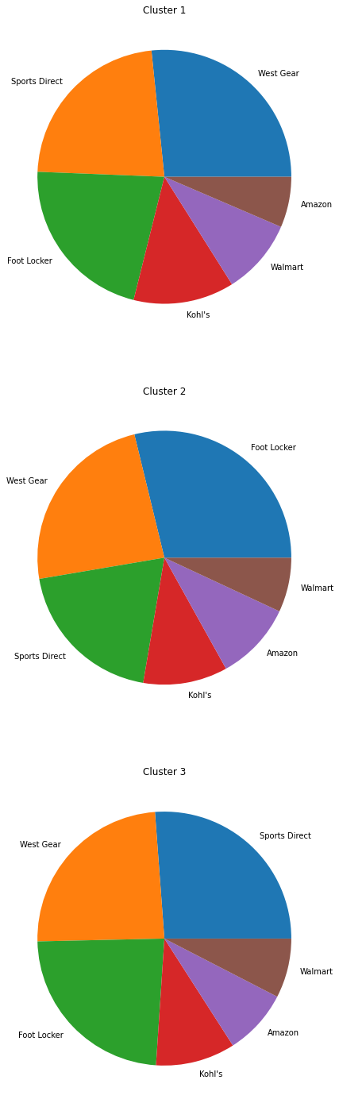
Business Insights in Clusters (Retailer and Region - optional)
Cluster 1 (Low operating margin and high averages of other features)
Cluster 2 (Low operating margin and low averages of other features)
Cluster 3 (High operating margin and low averages of other features)

Slide 20
Clustering (Only 2 Clusters)

Slide 21
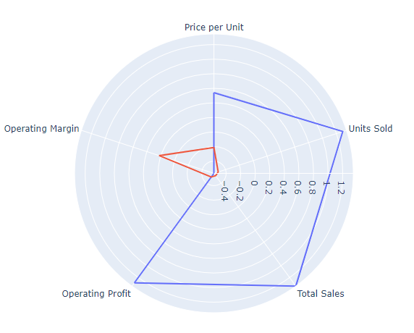
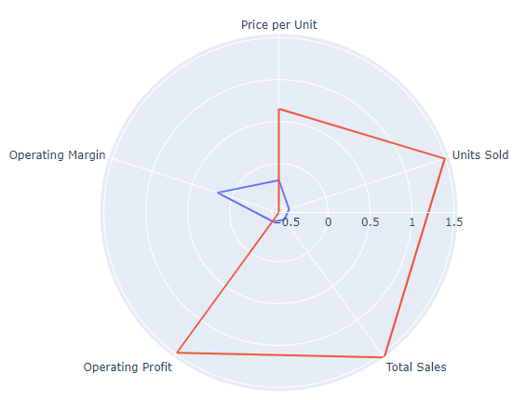
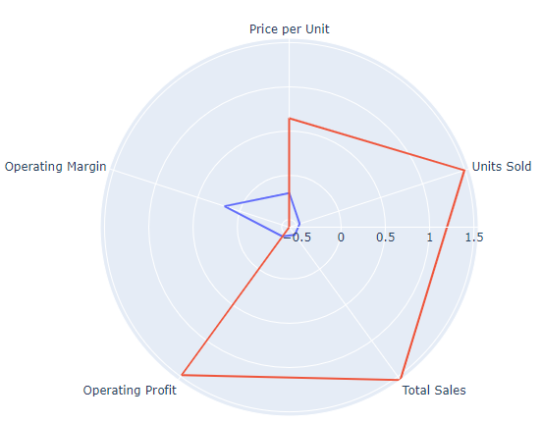
K- Prototype Clustering
Clustering technique Selection
K – means clustering was initially performed as the base level clustering to compare the results based on the mean
Hierarchal and K-prototype clustering was done going forward. However, all three techniques resulted in clusters with similar characteristics
As K-prototype had the ability to cluster categorical features based on the mode, it was chosen to better interpret the clusters
Hierarchal
Clustering
K- means
Clustering

Slide 22
Clustering (K- means Method)
2 clusters have been passed as the parameter as per the elbow graph and testing the cluster characteristics with higher numbers
The clusters formed distinctly had the following features
Cluster 1 (red): Low operating margin but the other features are trending high
Cluster 2 (blue): High operating margin but other features are performing low

Slide 23
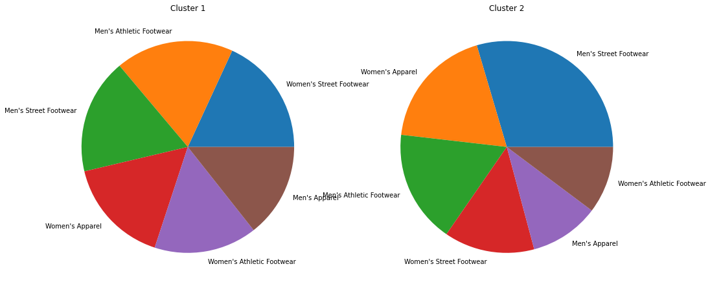
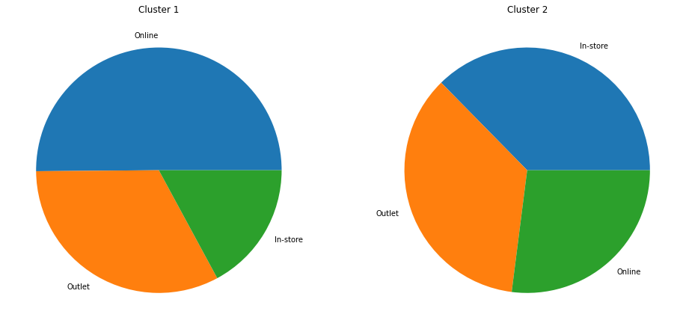
Business Insights in Clusters (Sales method and Product)
Cluster 1 (Low operating margin and high averages of other features)
Highest Online Sales
Cluster 2 (High operating margin and low averages of other features)
Lowest in online sales

Slide 24
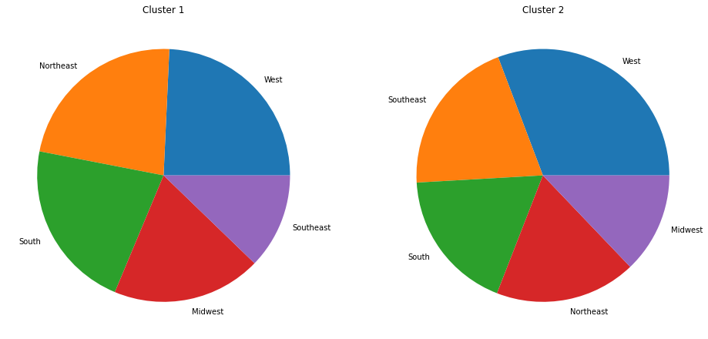
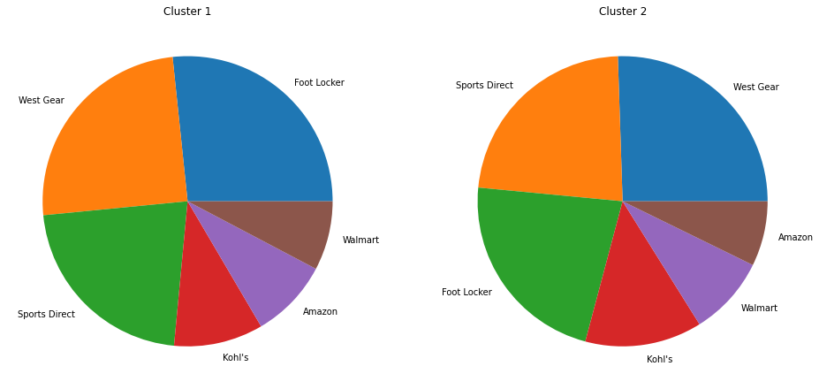
Business Insights in Clusters (Region and Retailer)
Cluster 1 (Low operating margin and high averages of other features)
Highest Online Sales
Cluster 2 (High operating margin and low averages of other features)
Lowest in online sales

Slide 26
Thank You

